Slide 1

Python Basics

Slide 2
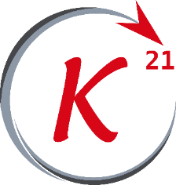
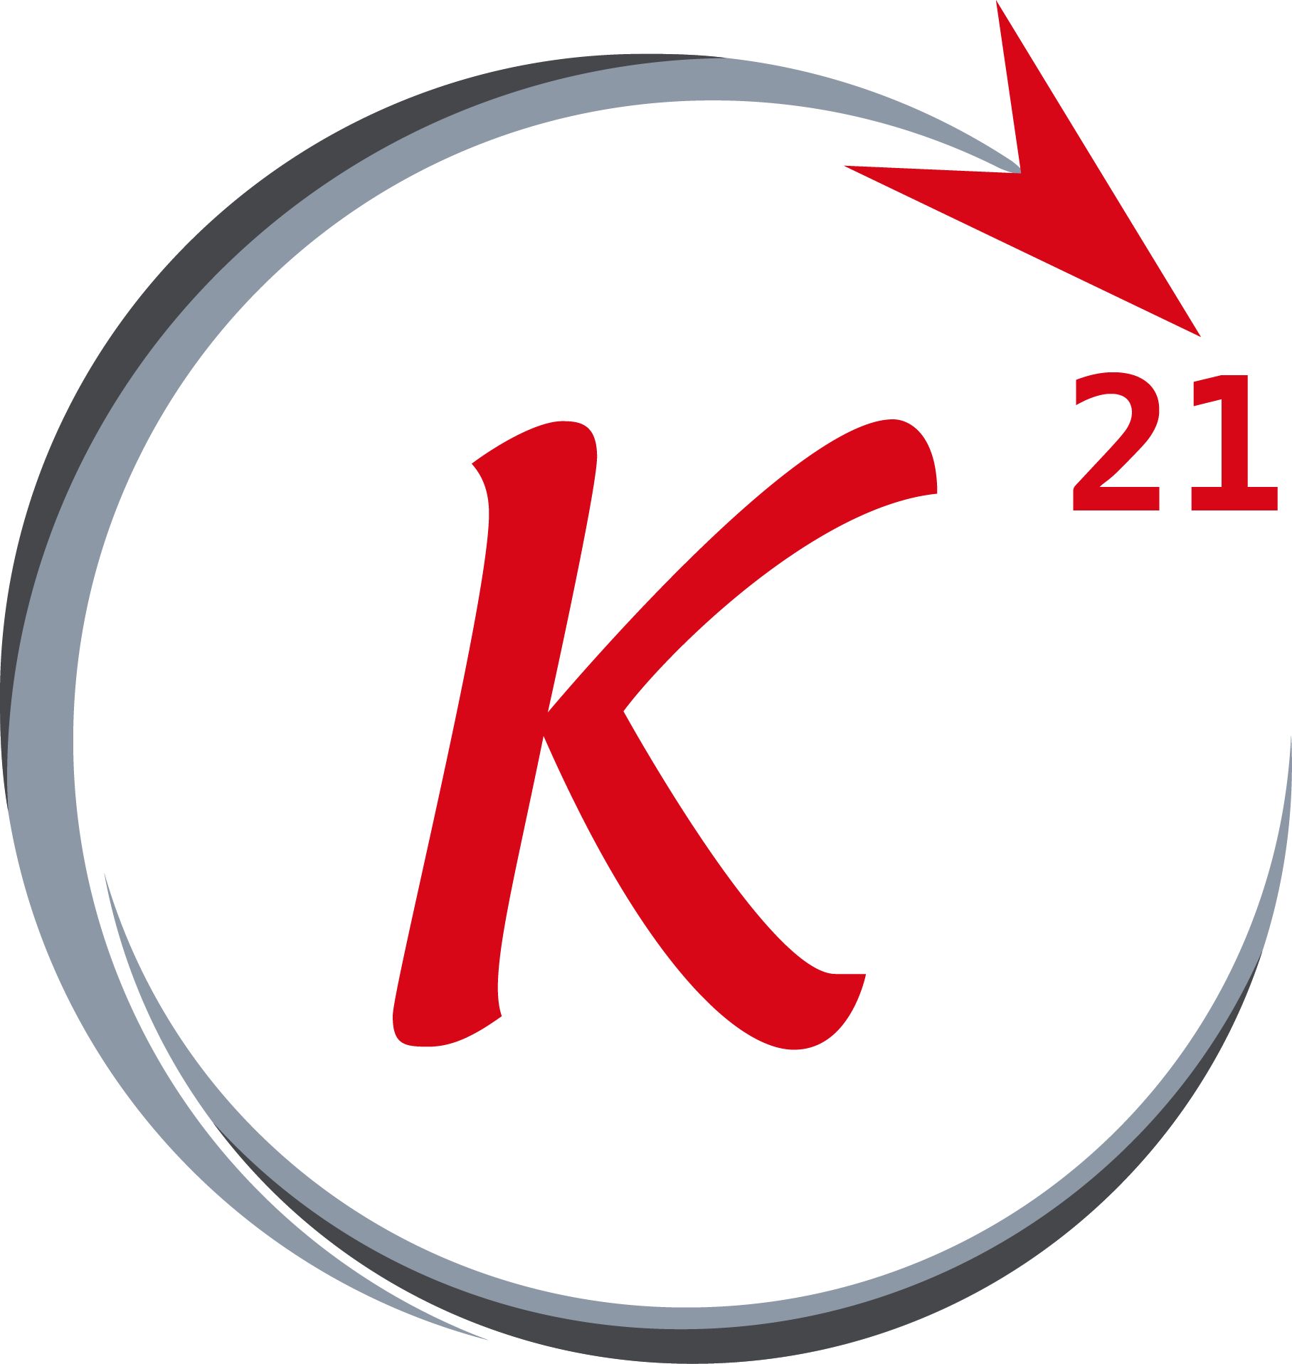


Python
Outline
About python
Program compilation
Installation
Syntax
Data types (1)
Arithmetic operations
Data types (2)
Logic and execution flow
Functions
Classes
Grow Through

Slide 3
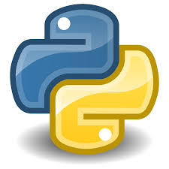
About Python
History
Python is a general-purpose programming language first introduced in 1991 by Guido van Rossum .
With python 2.0 being released in 2000 , and python 3.0 released in 2008 .
It is a high-level and dynamically typed language with garbage-
collection feature .
Grow Through

Slide 4
Program compilation
Python bytecode and P.V.M.
Python code is first compiled to python bytecode, a lower level language that python’s virtual machine uses to execute each line of code typed in the source code, the PVM is installed by the python installer and runs on top of the operating system (Windows, MacOS, etc.. ) .
The bytecode when cached is stored in .pyc & .pyo files and if no change made in the source code file, python skips the compilation to bytecode process and uses the old cached bytecode file .
Grow Through

Slide 5
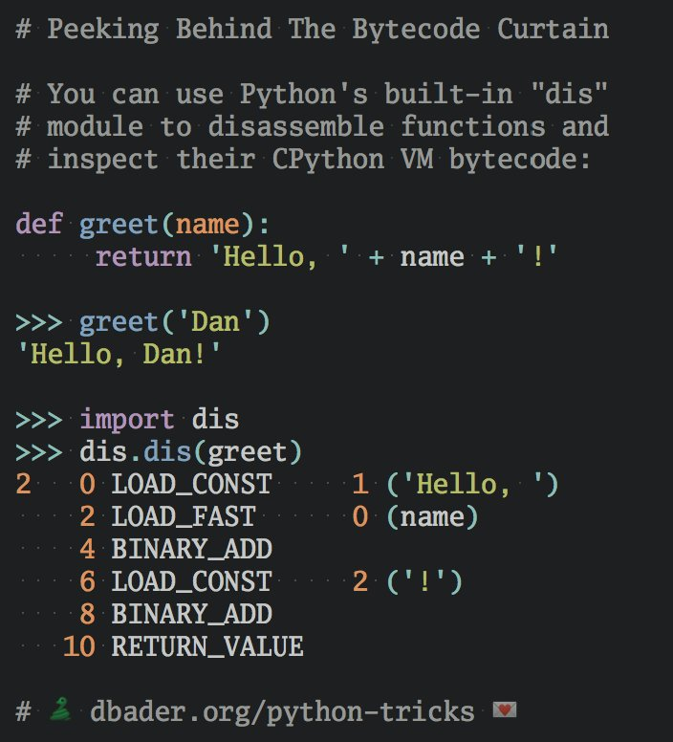
Program compilation
Python bytecode and P.V.M.
By dbader
Grow Through

Slide 6
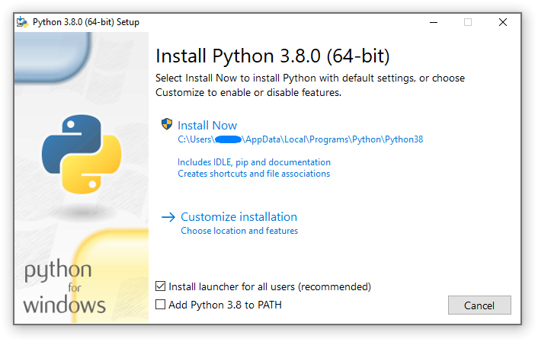
Installation
Python & IDLE
Python can be downloaded from the official website www.python.org .It comes with IDLE which is a simple python text editor used to type and edit python files .
We will be using python 3.8.x in this workshop .
Grow Through

Slide 7
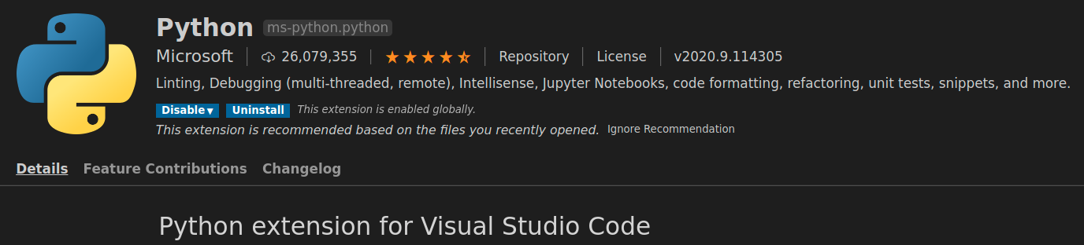
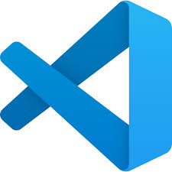
Installation
IDE : VS-Code
A very popular and open-source IDE to use is visual studio code, it has a python extension made and maintained by Microsoft makes writing python code an easy task .
Grow Through

Slide 8
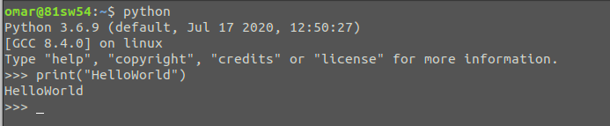
Installation
Running a python program
Use python interpreter to run simple python code, python interpreter can be opened using python.exe program or calling “python” on any of the command line tools if python is already added to the PATH .
Grow Through

Slide 9
Syntax
Variables
variables are the names of an object in python .When we try to call an object we use the name referring to it .
>>> x = 4
>>> type(x)
<class `int`>
>>> y = 4.0
>>>type(y)
<class `float`>
>>>print(x, y)
4 4.0
Grow Through

Slide 10
Syntax
#
Comments
There is no mutli-line comments in python . :(
Grow Through

Slide 11
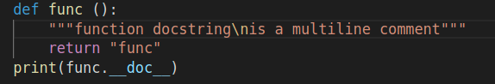
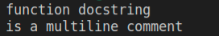
Syntax
Docstrings
Docstring is a commented string that is used to document objects in python .
It’s used by inserting the comment inside a triple double or single quotes .
Docstrings and comments aren’t so much alike, docstring doesn’t get ignored by the compiler like regular comments but is stored inside the program can can be viewed in program's life time .
Outputs
Grow Through

Slide 12
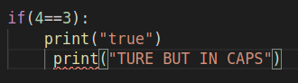
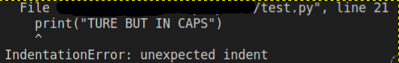
Syntax
Indentation
Indentation is a way in python to determine the scope of objects, like the curly braces in other programming languages .
We always indent a block of code one space or more to represent that it’s inside another block and all the lines of the inner block must be indented the same amount of spaces, otherwise this causes an indentation error .
Grow Through

Slide 13
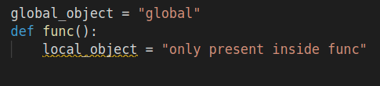
Syntax
Scopes
A scope of an object are the places on the code that the object can be called in and be recognized by the interpreter .
An object generally has the scope of its indentation level, for zero indentation level the object would have a global scope, if the object is defined inside a function then it will be available inside its function only ( will have its function’s inner scope ) .
Grow Through

Slide 14
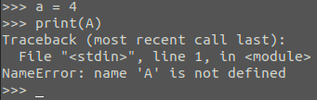
Syntax
Case sensitivity
Python is a case-sensitive language .
Grow Through

Slide 15
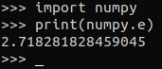
Syntax
Import Statement
“import” keyword is used to include a python package, module, class, function, etc ... into the current python project so these objects can be called inside the source code .
Grow Through

Slide 16
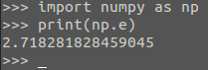
Syntax
Import Statement
“import” keyword can be used in many different forms, one of them is “import _ as _” .
Grow Through

Slide 17
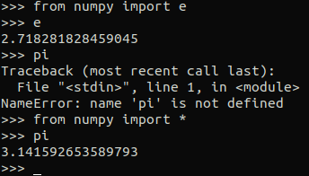
Syntax
Import Statement
but pi wasn’t :(
e was detected
* means all, so it basically
tells python to import the
whole module and attach
it to the current name-
space .
Grow Through

Slide 18
Syntax
Search path for import
An import statement will search for the mentioned module in the following order :
current folder
echo $PYTHONPATH
sys.path
Grow Through

Slide 19
Data types -1
int
int is a data type that stores integers, its initial size is 24 bytes and can scale up to as much memory as the machine can give . Also we don’t need to specify a data type for the variable we store our object in and we can change the variable’s data type later on the code due to python being dynamically-typed language .
>>>x = 4
>>>type(x)
<class `int`>
>>>import sys
>>>sys.getsizeof(x)
28
Grow Through

Slide 20
Data types -1
float
float is a date type that stores floating point numbers, i.e. any real number to a limited precision .
>>>x = 4.0
>>>type(x)
<class `float`>
>>>import sys
>>>sys.getsizeof(x)
24
Grow Through

Slide 21
Data types -1
string
A data type used to store a sequence of characters .
>>>x = “my string”
>>>type(x)
<class `str`>
>>>import sys
>>>sys.getsizeof(x)
57
Grow Through

Slide 22
Data types -1
casting
Casting is the process of converting one data type to another .
>>>x = int(54.34) >>>x = float(45)
>>>print(x) >>>print(x)
54 45.0
>>>type(x) >>>type(x)
<class `int`> <class `float`>
Grow Through

Slide 23
Data types -1
casting
Casting can also be done with strings .
>>>x = int(“54”) >>>x = float(“45.34”)
>>>print(x) >>>print(x)
54 45.34
>>>type(x) >>>type(x)
<class `int`> <class `float`>
Grow Through

Slide 24
Data types -1
boolean
boolean is a value that represents one of two states, True or False, being equal to 1 or 0 respectively . Note also that any number other than 0 can represent the True state .
>>>x = True >>>x = False
>>>print(x) >>>print(x)
True False
>>>type(x) >>>type(x)
<class `bool`> <class `bool`>
>>>bool(1) >>>bool(0.0)
True False
Grow Through

Slide 25
Data types -1
None
None is a reserved keyword in python used to define a no value . None is not the same as 0, False, or an empty string. None is a data type of its own (Nonetype) and only None can be None .
>>>x = None >>>None == None
>>>type(x) True
<class `Nonetype`> >>>None != None
>>>bool(x) False
False
>>>None == False
False
Grow Through

Slide 26
Arithmetic operations
+
Addition
Grow Through

Slide 27
Arithmetic operations
-
Subtraction
Grow Through

Slide 28
Arithmetic operations
Multiplication
*
strings can also be multiplied by an integer n resulting a repeated string n times
Grow Through

Slide 29
Arithmetic operations
Division
/
For integer division we use double slash instead of a single one
Grow Through

Slide 30
Arithmetic operations
Modulo
%
Modulus also works with floating point numbers in python
Grow Through

Slide 31
Arithmetic operations
Power
**
Grow Through

